Slide 1

Welcome

Slide 2
Data Analysis And Visualization
by
Priyanka Alugolu
Siva Chandra
Kakarlapudi
Sumanth Varma Dandu
Covid-19 Data Analysis

Slide 3
Agenda
Intent & Dataset Illustration
Data Loading & Data Cleaning
Data Analysis & Manipulation
Data Visualization
Conclusion
References

Slide 4
Objective and Dataset Description
The Covid-19 dataset we selected provides three csv-formatted metrics per day for each country's cases.
Confirmed cases per each day
Recovered cases per each day
Reported death cases per each day
The aim of this study is to analyze the number of COVID-19 cases across the world and to identify the trends since the pandemic began. Data visualization techniques will be used to compare the number of confirmed cases to the number of recovered cases in various countries and to depict the overall trend of confirmed cases.

Slide 5
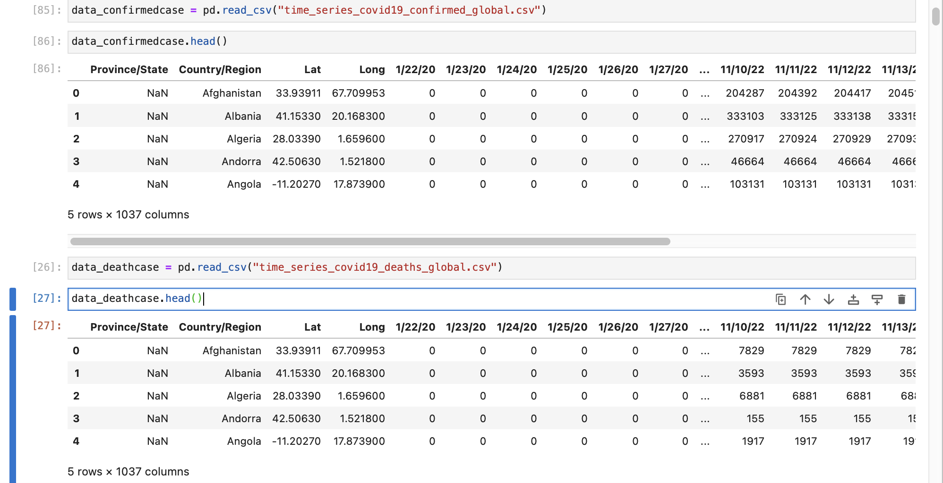
Data Loading & Data Cleaning
3 CSV files containing daily figures of confirmed, recovered, and deceased COVID-19 cases are available.
The Pandas package is used for data loading in order to transform datasets into data frames.

Slide 6
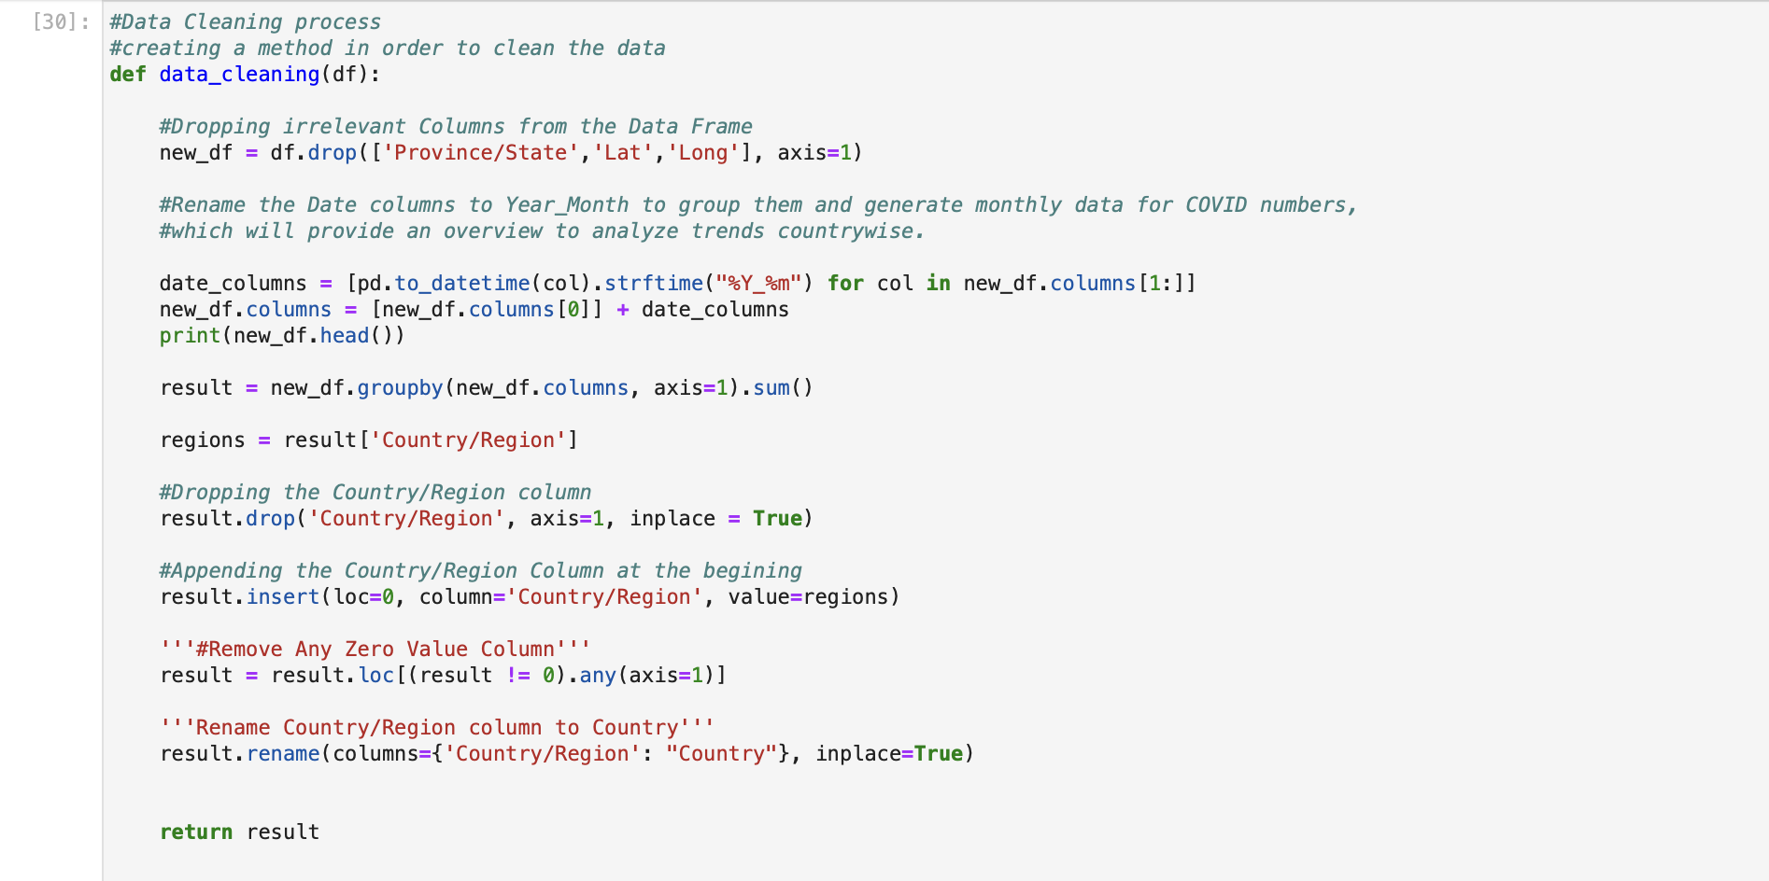
Data Loading & Data Cleaning
Data cleaning involves removing or correcting inaccurate data, filling in missing values, and transforming variables to make them more useful.
Data conversion includes transforming the data from one type of data structure to another i.e. used to do the conversion of date columns.

Slide 7
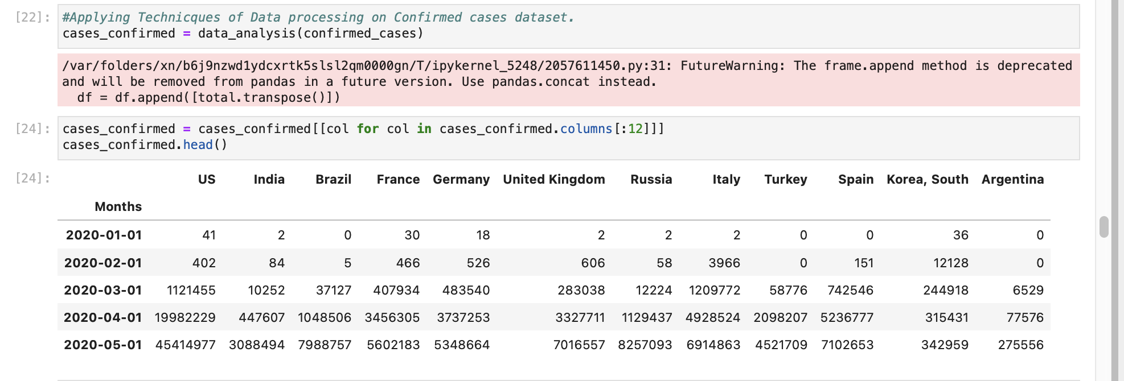
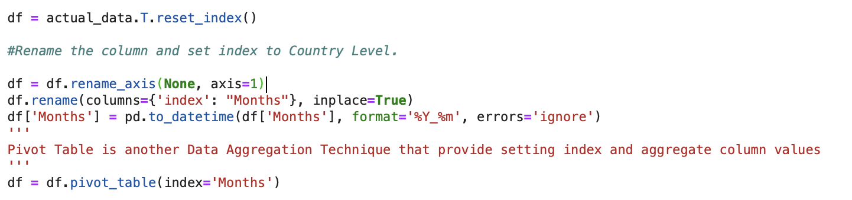
Data Loading & Data Cleaning
Data Wrangling & Aggregation techniques like ‘pivoting’ & ‘group by’ to summarize the data frame on date axis. This allowed us to perform time series analysis over data.
Data wrangling is a process of working with raw data and transform it to a format where it can be passed to further exploratory data analysis.

Slide 8
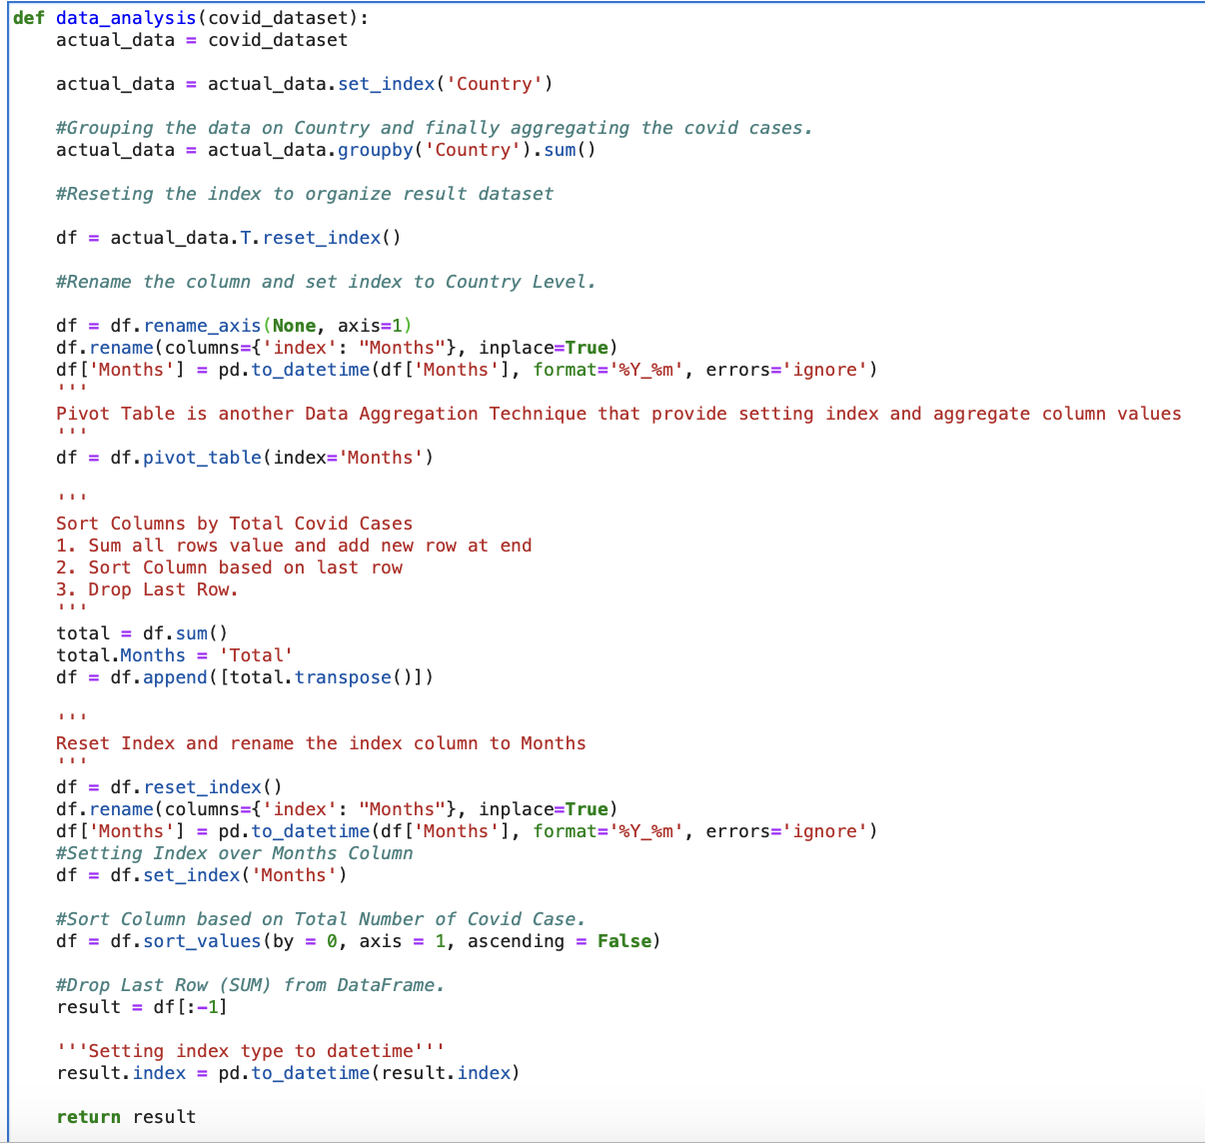
Data Analysis & Manipulation
On improved data frames, data modification techniques such month and year grouping, adding an index over a date, and hierarchical indexing are utilized.
most COVID-infected top 12 countries A portion of the dataset sample that had 19 instances was used for various analytics and visualizations.

Slide 9
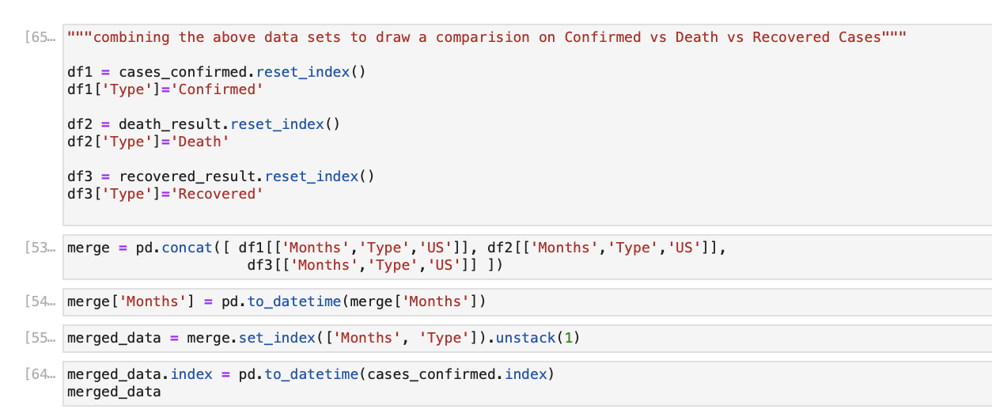
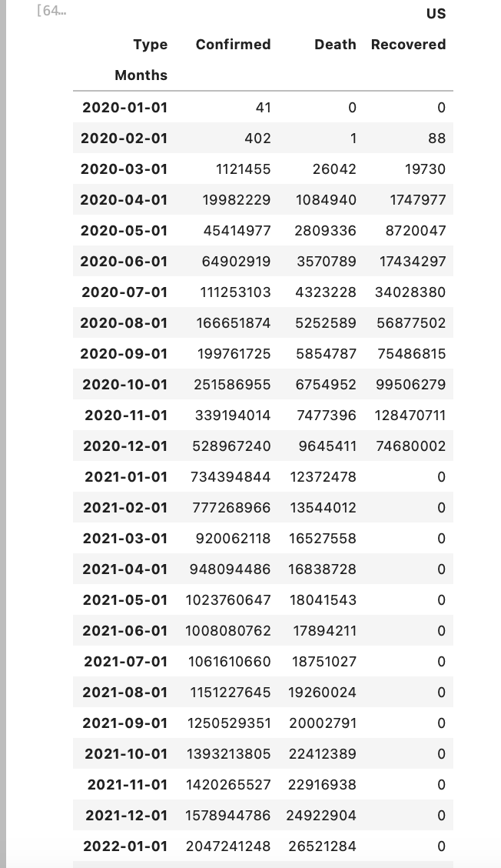
Data Analysis & Manipulation
To offer a day-by-day comparison of confirmed cases, received cases, and deaths ascribed to the novel COVID19 virus, three datasets are integrated using the "Concat" method.
Comparison of three categories for "US" is shown using sample data.

Slide 10
Data Visualization
Basic plot
Horizontal Bar plot
Time Series
Pie Chart

Slide 11
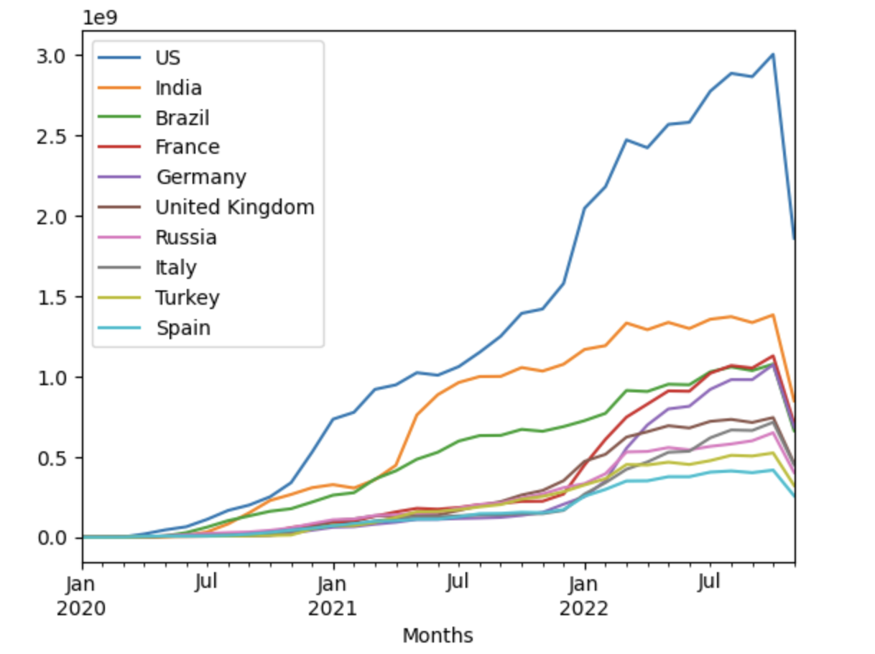
Basic plotting: plot
This plot shows a clear figure of the overall trend of Covid confirmed cases of first 10 columns.

Slide 12
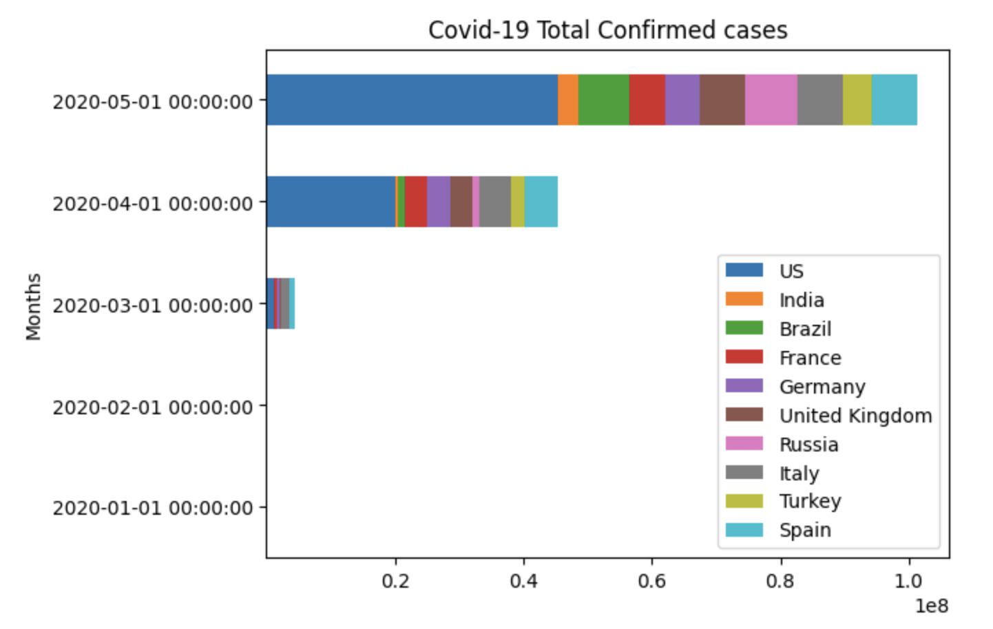
Bar Graph

Slide 13
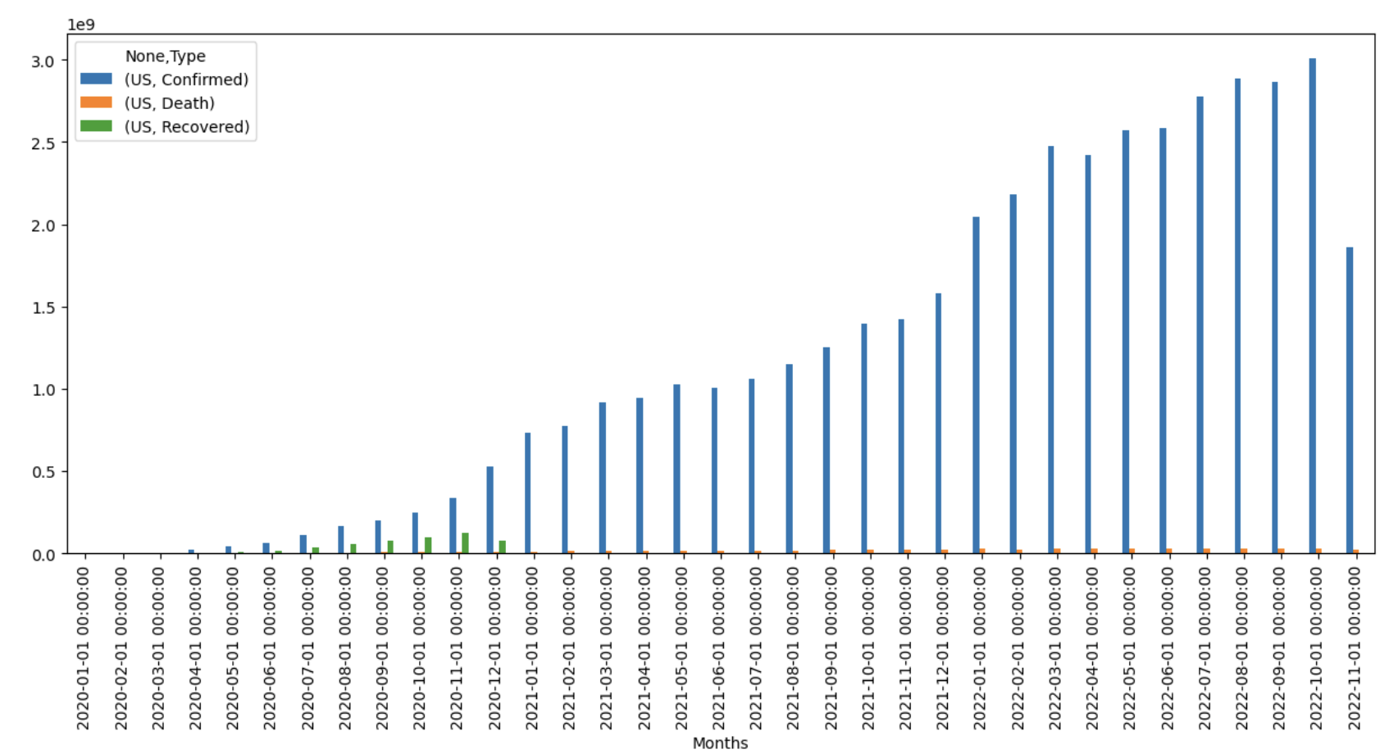
Data Visualization
The comparison of Daily Confirmed Cases, Recovered Cases, and Death Reported is shown using a bar chart.
To display the bar chart, a small sample for a single country(US) was taken.

Slide 14
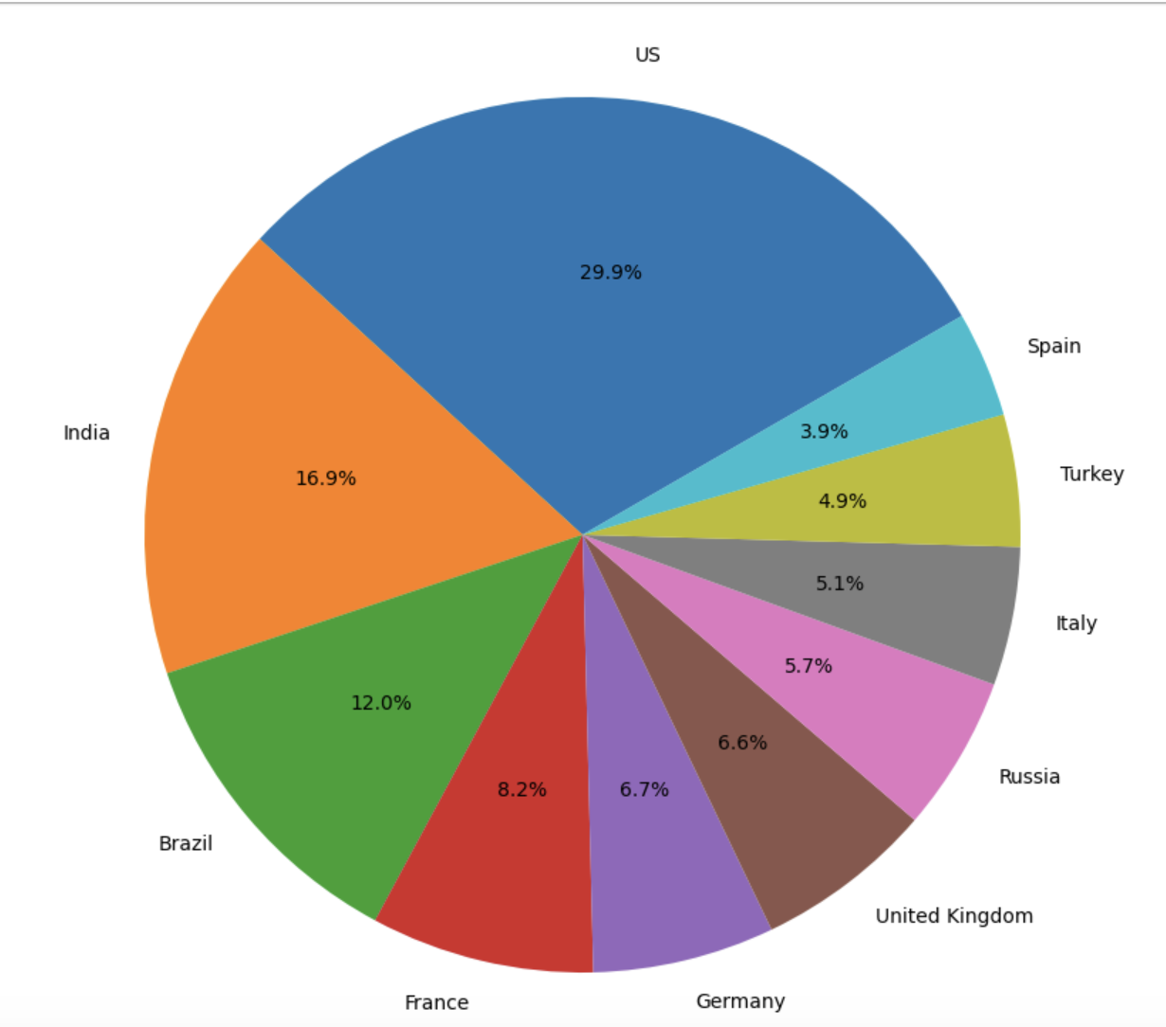
Data Visualization
The percentage of confirmed cases reported in each country relative to the overall number of cases is displayed using a pie chart.
To describe bar chart analysis, a subset of the dataset sample of the top 10 nations with the greatest COVID 19 instances was used.

Slide 15
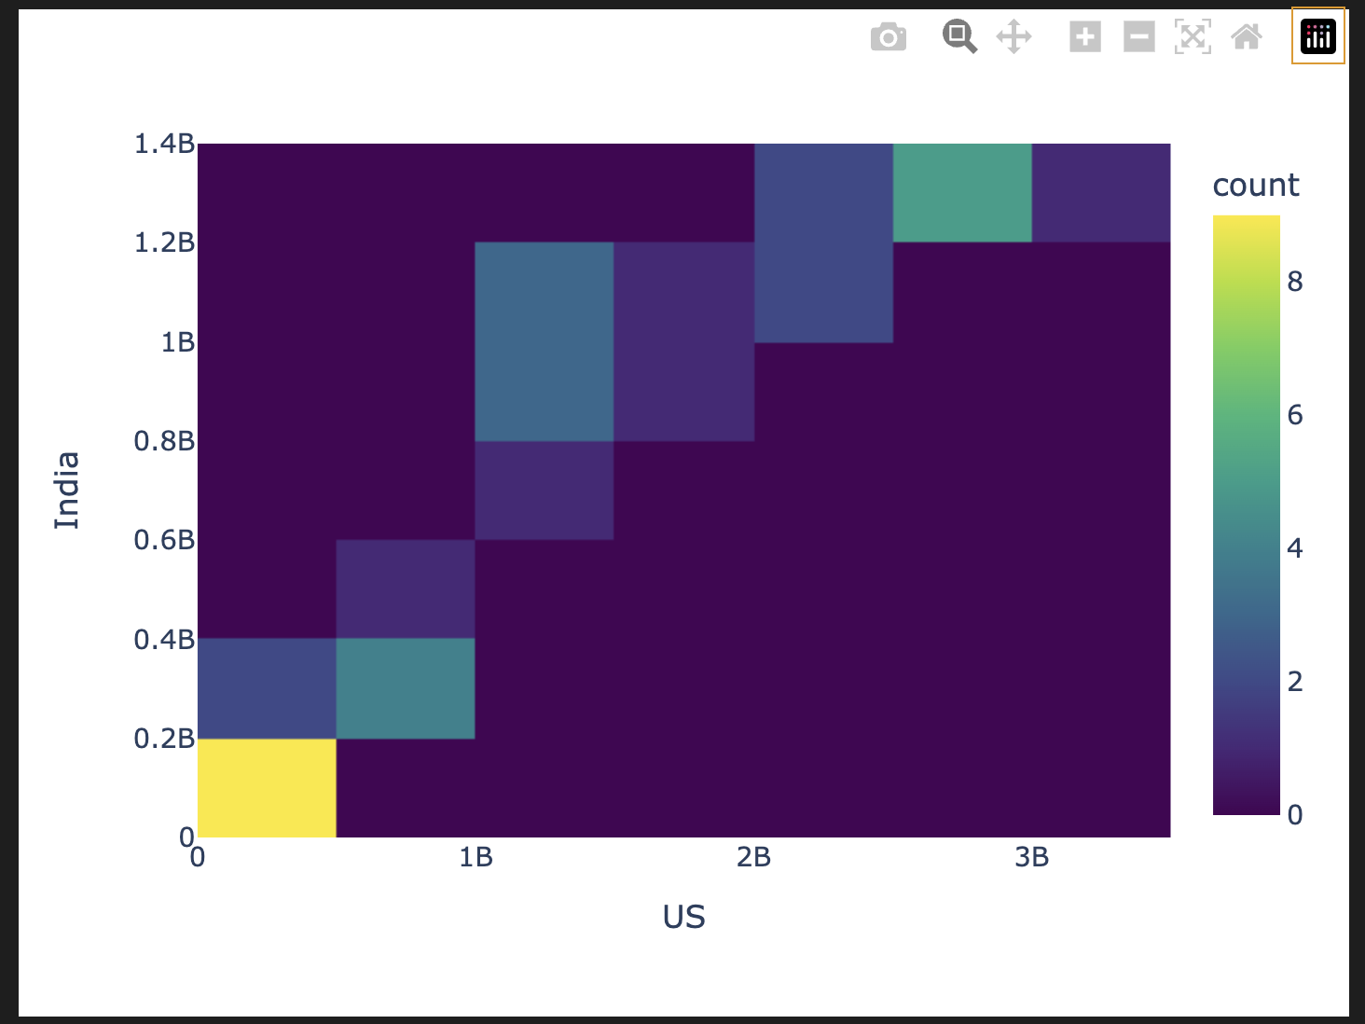
DENSITY Heat Map

Slide 16
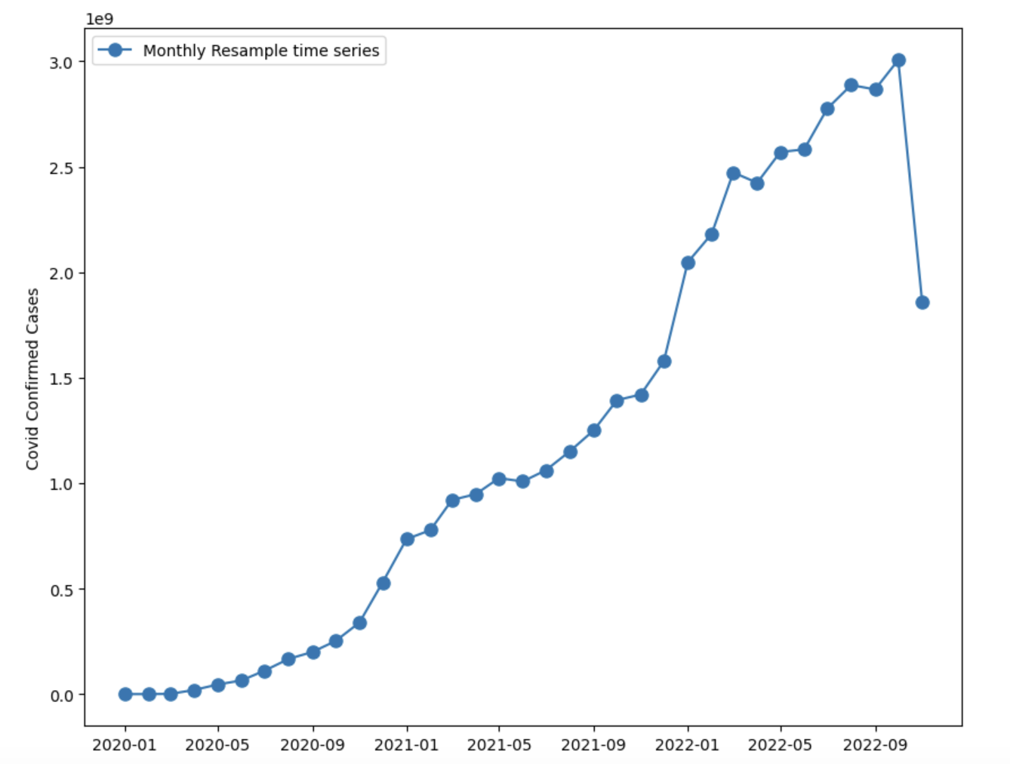
The Final chart to show the Time Series of Confirmed Covid 19 cases in US

Slide 17
Conclusion
This project taught us how to combine and preprocess datasets to generate the necessary metrics and put them up for analysis.
We were able to analyze and depict the global trend of COVID19 cases thanks to this investigation.

Slide 18
References
Dataset reference - https://github.com/CSSEGISandData/COVID-19
https://pandas.pydata.org/docs/user_guide/indexing.html
https://towardsdatascience.com/the-data-science-trilogy-numpy-pandas-and-matplotlib-basics-42192b89e26
https://www.kaggle.com/code/chats351/introduction-to-numpy-pandas-and-matplotlib

Slide 19

Thank you!

